Slide 1
Solving Linear Equations
Algebra I | Module 3 | Topic 1 | Lesson 1
Notes:
Note: Total suggested pacing for this lesson is two 45-minute sessions.

Slide 2
Objectives
Write equivalent equations using properties of equality.
Use properties of equality to solve linear equations and justify a solution method.
Determine whether an equation has one solution, no solution, or infinite solutions.
Solve linear equations with variables on both sides.
Notes:
TEKS:
A.1D: communicate mathematical ideas, reasoning, and their implications using multiple representations, including symbols, diagrams, graphs, and language as appropriate.
A.1F: analyze mathematical relationships to connect and communicate mathematical ideas.
A.1G: display, explain, and justify mathematical ideas and arguments using precise mathematical language in written or oral communication.
A.5A: solve linear equations in one variable, including those for which the application of the distributive property is necessary and for which variables are included on both sides.
ELPS:
1.H: develop and expand repertoire of learning strategies such as reasoning inductively or deductively, looking for patterns in language, and analyzing sayings and expressions commensurate with grade-level learning expectations.
2.B: recognize elements of the English sound system in newly acquired vocabulary such as long and short vowels, silent letters, and consonant clusters.
2.H: understand implicit ideas and information in increasingly complex spoken language commensurate with grade-level learning expectations.
4.B: recognize directionality of English reading such as left to right and top to bottom.

Slide 3
Key Terms (1 of 3)
solution [solución]: the solution to an equation is any value for the variable that makes the equation a true statement
Example
  The solution of the equation 3x + 4 = 25 is 7 because 7 makes the equation true: 3(7) + 4 = 25, or 25 = 25.
Notes:
Note: Solution is introduced on Day 1.

Slide 4
Key Terms (2 of 3)
no solution [sin solución]: an equation with no solution means that there is no value for the variable that makes the equation true
Example
  The equation 2x + 1 = 2x + 3 has no solution.
Notes:
Note: No solution is introduced on Day 1.

Slide 5
Key Terms (3 of 3)
infinite solutions [soluciones infinitas]: an equation with infinite solutions means that any value for the variable makes the equation true
Example
  The equation 2x + 1 = 2x + 1 has infinite solutions.
Notes:
Note: Infinite solutions is introduced on Day 1.

Slide 6
Essential Question (1 of 2)
You know that equations are one way to represent a linear function, and you have used equations to evaluate linear functions for a given input value.
How can you use equations to solve for unknown input values
of a function?
Notes:
Setting the Stage:
Tap into your student’s prior learning by reading the narrative statement.
Provide a sense of direction by reading the Essential Question.

Slide 7
Day 1
1
Notes:
Note: Total suggested pacing for Day 1 is 45 minutes.

Slide 8
Getting Started
15
Notes:
Note: Total time of 15 minutes allotted for the Getting Started.

Slide 9
Equation Creation (1 of 7)
An equation is a mathematical sentence that uses an equals sign
to show that two expressions are equivalent. When one of those expressions contains a variable, you can solve the equation.
Consider the equation x = 2. You can substitute the value 2 for x to
create the true statement 2 = 2. Because this is the only value that
makes the statement true, 2 is the only solution to the equation x = 2.

Slide 10
Equation Creation (2 of 7)
By performing the same operation on each side of an equation, you can create more complex equations that have the same solution.
A solution to an equation is a value for the variable that makes the equation a true statement.

Slide 11
Equation Creation (3 of 7)
Consider the equation x = 2.
Choose any constant. Add that constant to each side of the equation and simplify.
Choose any constant other than 0. Multiply each side of the equation you created in part (a) by that constant and simplify.
Notes:
Questions to Support Discourse – Gathering:
Which property did you use when you multiplied by a constant on the side of the equation with two terms?
Questions to Support Discourse – Probing:
What is another possible equation?
Demonstrate how you divided each side of the equation by a constant.

Slide 12
Equation Creation (4 of 7)
Choose any number other than 0 to represent a in the expression ax. Subtract the term ax from each side of the equation you created in part (b) and simplify.
Choose any constant other than 0. Divide each side of the equation you created in part (c) by that constant and simplify.
Notes:
Questions to Support Discourse – Gathering:
Which property did you use when you multiplied by a constant on the side of the equation with two terms?
Questions to Support Discourse – Probing:
What is another possible equation?
Demonstrate how you divided each side of the equation by a constant.

Slide 13
Equation Creation (5 of 7)
Have a partner solve the equation you created in Question 1 to verify that x = 2 is the solution.
Think about . . .
What strategies can you use to verify a solution?
Notes:
Questions to Support Discourse – Gathering:
Which property did you use when you multiplied by a constant on the side of the equation with two terms?
Questions to Support Discourse – Probing:
What is another possible equation?
Demonstrate how you divided each side of the equation by a constant.

Slide 14

Equation Creation (6 of 7)
Let’s summarize our learning from the Getting Started!
Notes:
Getting Started Summary:
An equation created by performing the same operation on each side of a solution statement will have the same solution as the starting statement.

Slide 15
Equation Creation (7 of 7)
Notes:
Note: This slide is blank for optional use with displaying work.

Slide 16
Activity 1.1
1.1
15–20
Notes:
Note: Total time of 15-20 minutes allotted for Activity 1.1.

Slide 17
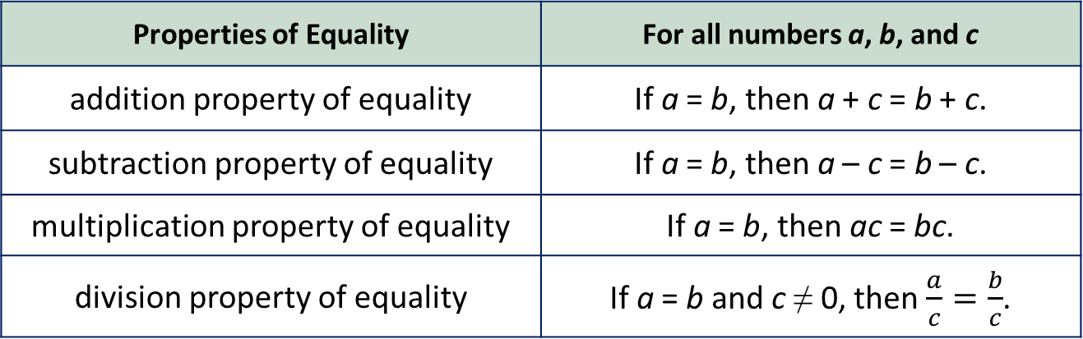
Using Properties to Justify Solutions (1 of 9)
Recall that the properties of equality are rules that allow you to maintain balance and rewrite equations to isolate the variable.
Properties of Equality | For all numbers a, b, and c
addition property of equality | If a = b, then a + c = b + c.
subtraction property of equality | If a = b, then a – c = b – c.
multiplication property of equality | If a = b, then ac = bc.
division property of equality | If a = b and c ≠ 0, then $\frac{a}{c}=\frac{b}{c}$.

Slide 18
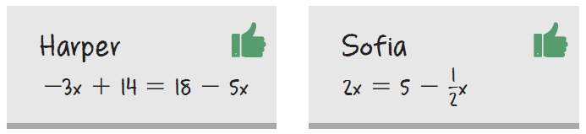
Using Properties to Justify Solutions (2 of 9)
Harper and Sofia both created new equations starting from the solution statement x = 2.

Slide 19
Using Properties to Justify Solutions (3 of 9)
Verify that both equations are equivalent to x = 2 using the given strategy.
substitution b. properties of equality
Notes:
Questions to Support Discourse – Gathering:
Explain what each property means in your own words.
Questions to Support Discourse – Probing:
Show how you applied each property in the Getting Started activity.
When using substitution, what result will verify that 2 is the solution?
Explain the steps you used to verify the solution using the properties of equality.
What is another way to apply the properties of equality and arrive at the same solution?

Slide 20
Using Properties to Justify Solutions (4 of 9)
There are also basic number properties that you are already familiar with that can be used to justify your steps when solving equations.
Number Properties | For all numbers a, b, and c
commutative property | a + b = b + a ab = ba
associative property | a + (b + c) = (a + b) + c a(bc) = (ab)c
distributive property | a(b + c) = ab + ac

Slide 21
Using Properties to Justify Solutions (5 of 9)
Justifying your steps with the properties of equality will better prepare
you for writing geometrical proofs in future courses.
Solve each equation and check your solution. Write the properties that justify each step of your solving strategy.
24x + 7 = –4x
Notes:
Questions to Support Discourse – Seeing Structure:
Create an example with numbers for each number property.
What is the difference between the commutative and associative properties?
Questions to Support Discourse – Probing:
What will your steps look like if you add 4x to both sides of the equation in part (a)?
What strategy did you apply to address the fraction in part (c)?
Why might someone multiply both sides of the equation by 2?
Why do you think Chloe chose 4 as the divisor?
Whose method do you prefer? Why?

Slide 22
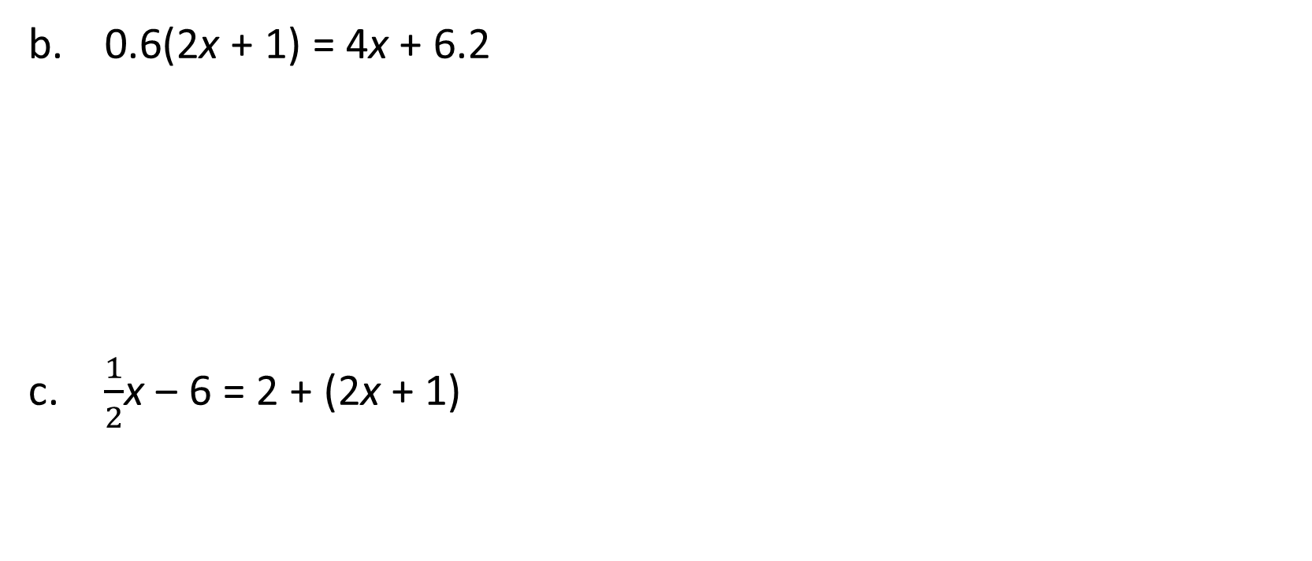
Using Properties to Justify Solutions (6 of 9)
0.6(2x + 1) = 4x + 6.2
$\frac{1}{2}$x ‒ 6 = 2 + (2x + 1)
Notes:
Questions to Support Discourse – Seeing Structure:
Create an example with numbers for each number property.
What is the difference between the commutative and associative properties?
Questions to Support Discourse – Probing:
What will your steps look like if you add 4x to both sides of the equation in part (a)?
What strategy did you apply to address the fraction in part (c)?
Why might someone multiply both sides of the equation by 2?
Why do you think Chloe chose 4 as the divisor?
Whose method do you prefer? Why?

Slide 23
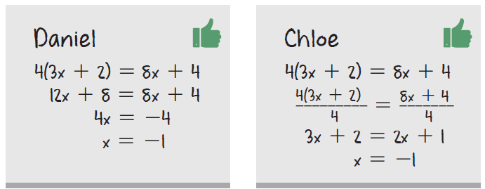
Using Properties to Justify Solutions (7 of 9)
Compare the solution strategies used by Daniel and Chloe. What do you notice about the properties each student used?
Notes:
Questions to Support Discourse – Seeing Structure:
Create an example with numbers for each number property.
What is the difference between the commutative and associative properties?
Questions to Support Discourse – Probing:
What will your steps look like if you add 4x to both sides of the equation in part (a)?
What strategy did you apply to address the fraction in part (c)?
Why might someone multiply both sides of the equation by 2?
Why do you think Chloe chose 4 as the divisor?
Whose method do you prefer? Why?

Slide 24
Using Properties to Justify Solutions (8 of 9)
Let’s summarize our learning from Activity 1.1!
Notes:
Activity 1.1 Summary:
The properties of equality as well as basic number properties are useful in solving equations and justifying the solution.

Slide 25
Using Properties to Justify Solutions (9 of 9)
Notes:
Note: This slide is blank for optional use with displaying work.

Slide 26
Activity 1.2
1.2
10–15
Notes:
Note: Total time of 10-15 minutes allotted for Activity 1.2.

Slide 27
Solutions to Linear Equations (1 of 8)
In the Getting Started, you built equations from x = 2. In this activity, you will build equations from two mathematical sentences and compare your results.

Slide 28
Solutions to Linear Equations (2 of 8)
Consider the mathematical sentence 2 = 2.
Is there any variable or constant that you could add, subtract, multiply, or divide to both sides using the properties of equality to make this true sentence false? Choose variables and constants to create new mathematical sentences to justify your conclusion.
Notes:
Questions to Support Discourse – Probing:
Demonstrate the results of applying each property of equality.
Questions to Support Discourse – Seeing Structure:
Explain what this question demonstrates.

Slide 29
Solutions to Linear Equations (3 of 8)
Consider the mathematical sentence 2 = 3.
Is there any variable or constant that you could add, subtract, multiply, or divide to both sides using the properties of equality to make this false sentence true? Choose variables and constants to create new mathematical sentences to justify your conclusion.
Notes:
Questions to Support Discourse – Probing:
Demonstrate the results of applying each property of equality.
Questions to Support Discourse – Seeing Structure:
Explain what this question demonstrates.

Slide 30
Solutions to Linear Equations (4 of 8)
A linear equation can have one solution, no solution, or infinite solutions. The equations you solved in the previous activity are examples of linear equations with one solution. A linear equation with no solution means that there is no value for the variable that makes the equation true. A linear equation with infinite solutions means that any value for the variable makes the equation true.

Slide 31
Solutions to Linear Equations (5 of 8)
Consider the equations you created in this activity.
Explain whether the equation(s) you created in Question 1 have one solution, no solution, or infinite solutions.
Explain whether the equation(s) you created in Question 2 have one solution, no solution, or infinite solutions.
Notes:
Questions to Support Discourse – Seeing Structure:
Provide examples to support your conclusion.
Use substitution to verify your solution.

Slide 32
Solutions to Linear Equations (6 of 8)
Consider the equation 2x = 3x. Does this equation have one solution, no solution, or infinite solutions? Explain your reasoning.
Notes:
Questions to Support Discourse – Seeing Structure:
Provide examples to support your conclusion.
Use substitution to verify your solution.

Slide 33
Solutions to Linear Equations (7 of 8)
Let’s revisit the Essential Question and summarize our learning from Activity 1.2!
Notes:
Note: To close Day 1, have students reread the Essential Question and then read the Stamp the Learning summary aloud.
Activity 1.2 Summary:
A linear equation can have one solution, no solution, or infinite solutions.

Slide 34
Solutions to Linear Equations (8 of 8)
Notes:
Note: This slide is blank for optional use with displaying work.

Slide 35
Day 1
2
Notes:
Note: Total suggested pacing for Day 2 is 45 minutes.

Slide 36
Essential Question (2 of 2)
How can you use equations to solve for unknown input values
of a function?
Notes:
Note: To begin Day 2, have a student read the Essential Question aloud.

Slide 37
Activity 1.3
1.3
35–40
Notes:
Note: Total time of 35-40 minutes allotted for Activity 1.3.

Slide 38
Tic-Tac-Bingo (1 of 5)
In this activity, you are going to play a game called Tic-Tac-Bingo. The object of the game is to match two expressions to create an equation with specific solution types. Use the Tic-Tac-Bingo sheet located at the end of the lesson.
Notes:
Note: The Tic-Tac-Bingo sheet and Expression Cards are located on slides toward the end of the deck.

Slide 39
Tic-Tac-Bingo (2 of 5)
Prepare the board.
The board has 9 spaces. Three spaces are already designated. Fill each remaining space with one of the solution types listed. Each option must be used at least once.
Play the game.
Your teacher will assign you an expression. When you and a classmate have created an equation with one of the solution types, write your equation in the corresponding box.
Solution Types
• positive rational solution
• negative rational solution
• non-zero integer solution

Slide 40
Tic-Tac-Bingo (3 of 5)
Try to be the first person to fill three spaces in a row. Then, try to be the first person to completely fill your board with equations.
Reflect on the equations you created.
How can you look at an equation and determine that it has no solution?
How can you look at an equation and determine that it has infinite solutions?
Notes:
Questions to Support Discourse – Gathering:
What is an example of a nonzero integer solution? A positive rational solution that is not an integer?
Questions to Support Discourse – Probing:
What strategy did you use to locate matches for your game card efficiently?
Questions to Support Discourse – Seeing Structure:
What type of solution will each of these equations have? Why?
2x + 5 = 2x + 5
2x + 5 = 2x + 7
2x + 5 = 3x + 5
2x + 5 = 3x + 7
How can you generalize the structure of these equation types and their type of solution?

Slide 41
Tic-Tac-Bingo (4 of 5)
Let’s summarize our learning from Activity 1.3!
Notes:
Activity 1.3 Summary:
A linear equation can have one solution, no solution, or infinite solutions.

Slide 42
Tic-Tac-Bingo (5 of 5)
Notes:
Note: This slide is blank for optional use with displaying work.

Slide 43
Talk the Talk
5–10
Notes:
Note: Total time of 5-10 minutes allotted for the Talk the Talk.

Slide 44
One Step at a Time (1 of 3)
Rectangle A has a width of (5 + 2x) inches and a length of 6 inches. Rectangle B has a width of 8 inches and a length of (x + 5) inches. Write and solve an equation to determine the length of x when both rectangles have the same area. Write the property that justifies each step to solve the equation.
Notes:
Questions to Support Discourse – Probing:
How do you know when to apply the distributive property?
When did you use the division property of equality?
Did everyone use the same properties regardless of how they solved the equation? Explain why or why not.

Slide 45
One Step at a Time (2 of 3)
Let’s answer the Essential Question and summarize our learning from the Talk the Talk!
Essential Question: How can you use equations to solve for unknown input values of a function?
Notes:
Note: To close Day 2, have students read and answer the Essential Question and then read the Stamp the Learning summary aloud.
Essential Question:
Sample answer: I can substitute a known output value into an equation representing a linear function. Then, I can solve the equation to find the unknown input value.
Talk the Talk Summary:
The properties of equality as well as basic number properties are useful in solving equations and justifying the solution.

Slide 46
One Step at a Time (3 of 3)
Notes:
Note: This slide is blank for optional use with displaying work.

Slide 47
Tic-Tac-Bingo Board

Slide 48
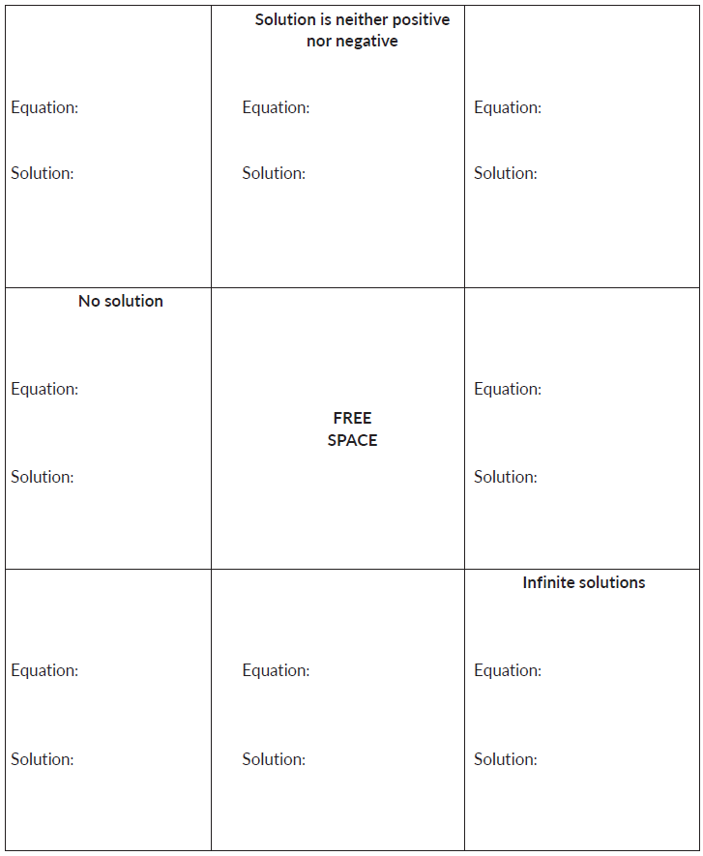
Tic-Tac-Bingo Board (1 of 1)

Slide 49
Expression Cards

Slide 50
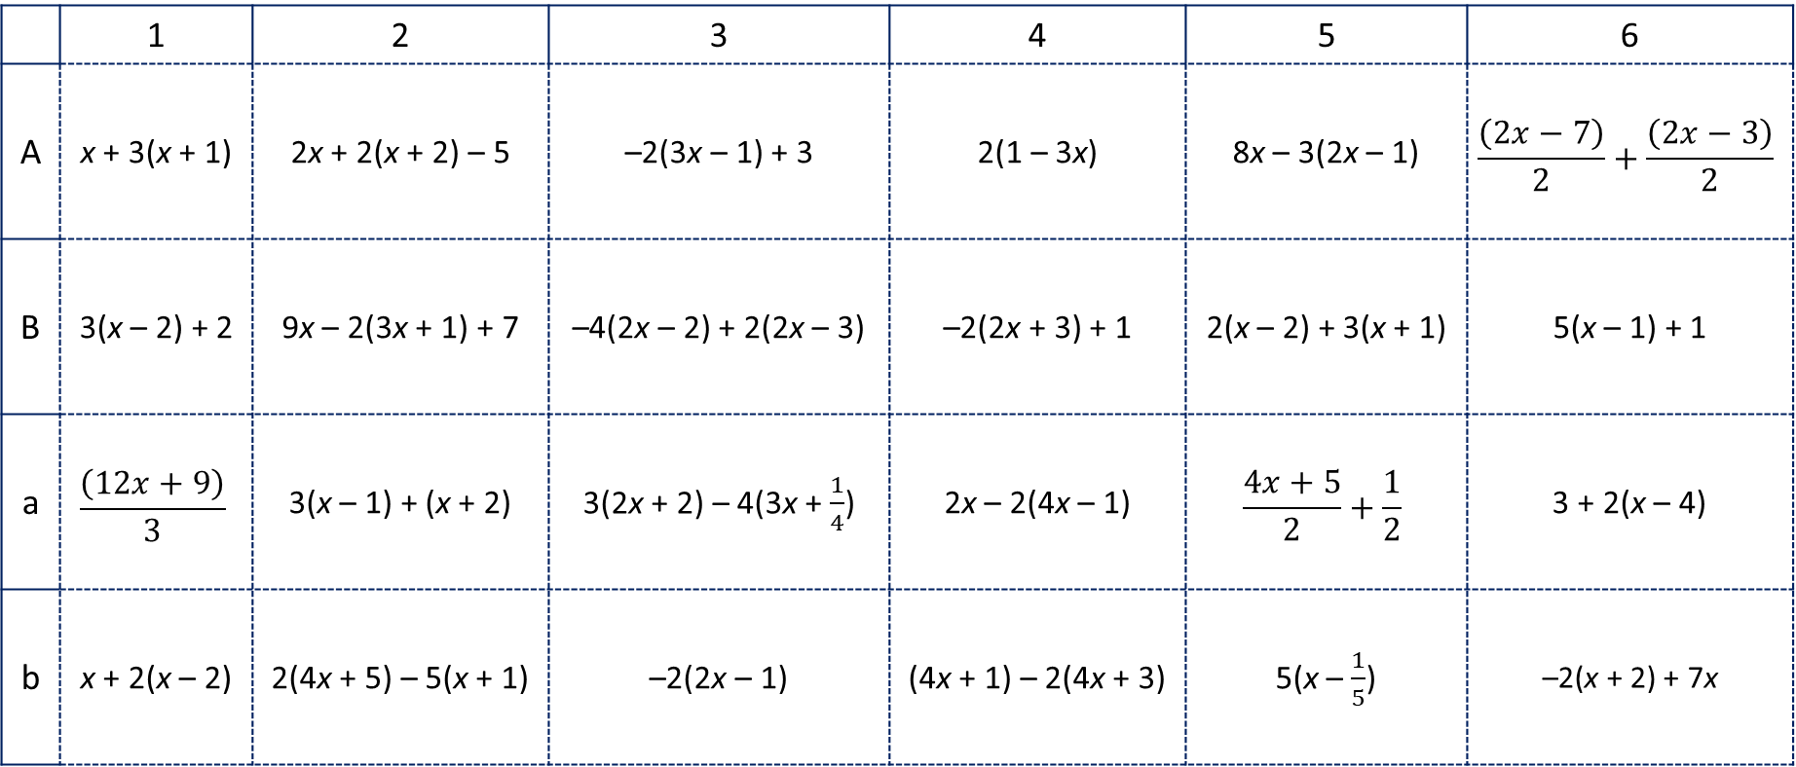
Expression Cards (1 of 1)
 | 1 | 2 | 3 | 4 | 5 | 6
A | x + 3(x + 1) | 2x + 2(x + 2) – 5 | –2(3x – 1) + 3 | 2(1 – 3x) | 8x – 3(2x – 1) | $$\frac{\left(2x−7\right)}{2}+\frac{\left(2x−3\right)}{2}$$
B | 3(x – 2) + 2 | 9x – 2(3x + 1) + 7 | –4(2x – 2) + 2(2x – 3) | –2(2x + 3) + 1 | 2(x – 2) + 3(x + 1) | 5(x – 1) + 1
a | $$\frac{\left(12x+9\right)}{3}$$ | 3(x – 1) + (x + 2) | 3(2x + 2) – 4(3x + $\frac{1}{4}$) | 2x – 2(4x – 1) | $$\frac{4x+5}{2}+\frac{1}{2}$$ | 3 + 2(x – 4)
b | x + 2(x – 2) | 2(4x + 5) – 5(x + 1) | –2(2x – 1) | (4x + 1) – 2(4x + 3) | 5(x – $\frac{1}{5}$) | –2(x + 2) + 7x

Slide 51
Prepare
Notes:
How can you identify whether students are ready for new learning? ​
Depending on available time, you can assign the Prepare section of the Lesson Assignments as homework or as a warm-up to identify students' prior knowledge for the upcoming lesson's activities.

Slide 52
Prepare for Module 3 Topic 1 Lesson 2
The formula for the circumference of a circle is C = 2πr. Determine the radius for each circle with the given circumference. Use 3.14 for π and round to the nearest tenth of a unit, if necessary.
C = 62.8 in. 3. C = 15.7 ft
C = 10 cm 4. C = 48 mm

Slide 53
Acknowledgment and Notice

Slide 54
BLMathematics_AlgI_M3_T1_L1_LessonSlides_ENG_2025

